Slide 1

CSC 486 - Human-Computer Interaction
Franz J. Kurfess
Professor
Computer Science Department
California Polytechnic State University
San Luis Obispo, CA, U.S.A.
fkurfess@calpoly.edu

Slide 2
Natural User Interfaces

Slide 3
Usage of the Slides
these slides are intended for the students of my CPE/CSC 486 “Human-Computer Interaction” class at Cal Poly SLO
some of them are based on the “Interaction Design” textbook used in the CPE/CSC 484 class on User-Centered Design and Development
www.id-book.com
some of them are based on other sources, which are identified at the bottom of the respective slide
if you want to use them outside of my class, please let me know (fkurfess@calpoly.edu)

Slide 4
Course Overview
Introduction
Cognitive Foundations
Input-Output Devices
Interaction Spaces
Interaction Styles
Interaction with Mobile Devices
Speech-Based Interaction
User Assistance
Natural User Interfaces
Case Studies
Project Presentations

Slide 5
Chapter Overview Natural User Interfaces
Motivation
Objectives
Terminology
NUI
Background
CLI => GUI => NUI
skills
cognitive load
Natural Interaction Guidelines
enable instant expertise
reduce cognitive load
induce progressive learning
utilize direct interaction
Natural Interaction Application
reuse innate abilities
reuse basic skills
acquire new skills
learn tasks
Important Concepts and Terms
Chapter Summary

Slide 6
Motivation

Slide 7
Objectives

Slide 8
Evaluation Criteria

Slide 9
Pre-Test
Notes:
find out about the background of the participants
establish formal prerequisites
sensitize participants to potential gaps in their background knowledge
affirm the students’ qualifications

Slide 10
Terminology
Natural User Interface
Natural Interaction

Slide 11
Natural User Interface
“A natural user interface is a user interface designed to use natural human behaviors for interacting directly with content.”
Blake, J. (2011). NUIs reuse existing skills.
(updated NUI definition)
http://nui.joshland.org/2010/04/nuis-reuse-existing-skills.html
Blake, J. (2011). Natural user interfaces in .NET : WPF 4, Surface 2, and Kinect.
Greenwich, Conn.; London: Manning ; Pearson Education [distributor].
Retrieved from http://manning.com/blake/

Slide 12
NUI Aspects
interaction design
NUIs should be natural for the user, not the developer
requires design and planning
appropriate for
user
content
context
skill re-use
builds upon experience and expertise
often unrelated to computer use
direct interaction with content
direct manipulation where possible
controls only when necessary

Slide 13
NUI Criticism
Don Norman: “ … the new interactions even have a new marketing name: natural, as in "Natural User Interface.”
Norman, Donald A. “Natural User Interfaces Are Not Natural.” Interactions 17, no. 3 (May 1, 2010): 6. doi:10.1145/1744161.1744163.
see also
Norman, Donald A., and Jakob Nielsen. “The Way I See it - Gestural Interfaces: A Step Backward in Usability.” Interactions 17, no. 5 (September 1, 2010): 46. doi:10.1145/1836216.1836228.

Slide 14
Natural Interaction
interaction methods the user is familiar and comfortable with
touch
gestures
speech
often built on metaphors drawn from real-world experiences
emphasis on interaction style
not so much on input modality
e.g. touch/speech vs. keyboard/mouse

Slide 15
Related Terms
Tangible User Interface
emphasis on interaction with physical objects
Organic User Interface
Flexible (or deformable) user interfaces
Shaped user interfaces: static, non-flat display
sphere, cylinder; real-world objects
Actuated (or kinetic) user interfaces: reconfigurable shape
Kinetic User Interface
emphasis on gestures

Slide 16
Natural Interaction Examples
touch-based
pinch, scroll, rotate, ...
gesture-based
Kinect, Wiimote, Leap Motion
voice
Siri, Alexa, Google Home, Samsung Bixby
augmented and virtual reality
mobile overlays
head-mounted devices (Oculus Rift, HTC Vive, Google Glass)
VR studios

Slide 17
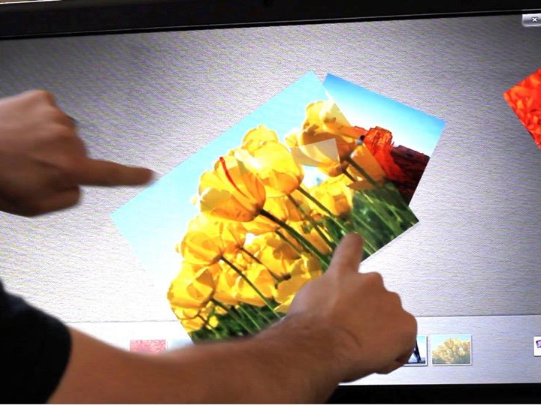
Pinch
Marco Silva, DevScope: How NUIs are changing HCI; http://marconsilva.livethoughts.net

Slide 18
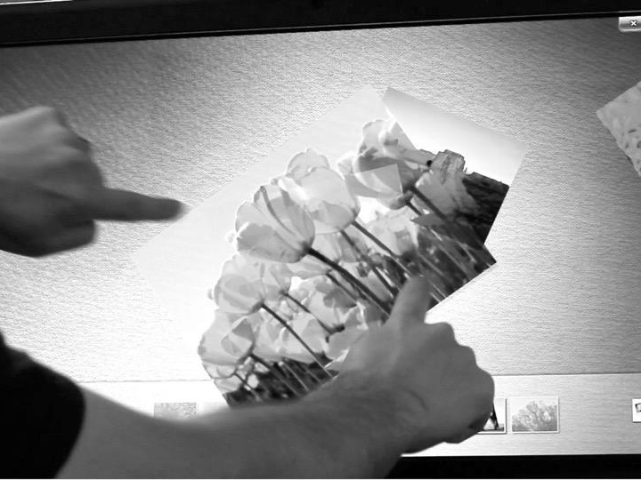
2 Finger Scroll
Swipe
Rotate
Flicks
Marco Silva, DevScope: How NUIs are changing HCI; http://marconsilva.livethoughts.net

Slide 19
Natural Photo Manipulation
differences between manipulation of photos on a light table and a touch-based computer interface
Modification | Real World: Light Table | Computer: Touch Interaction
Movement
Size
Color, Light, Contrast,
Effects

Slide 20
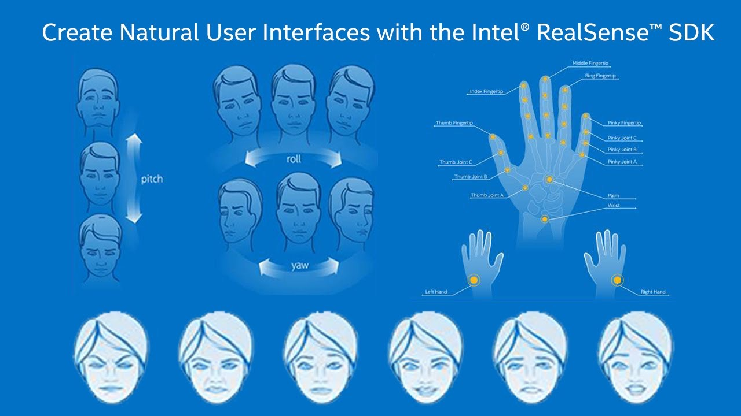
NUI with Intel RealSense
https://i.ytimg.com/vi/Sr5qRPSHvyA/maxresdefault.jpg

Slide 21
Background
CLI => GUI => NUI
Direct Manipulation
Skills
Cognitive Load

Slide 22
CLI => GUI => NUI => OUI
evolution of user interfaces
Command Line Interface
Graphical User Interface
Natural User Interface
Organic User Interface

Slide 23
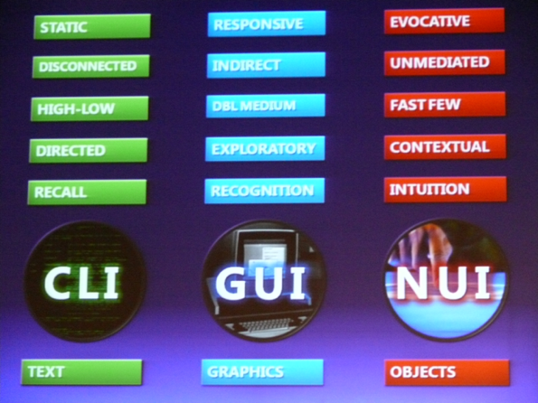
http://www.flickr.com/photos/roguemm/2890425768/sizes/o/in/photostream/

Slide 24
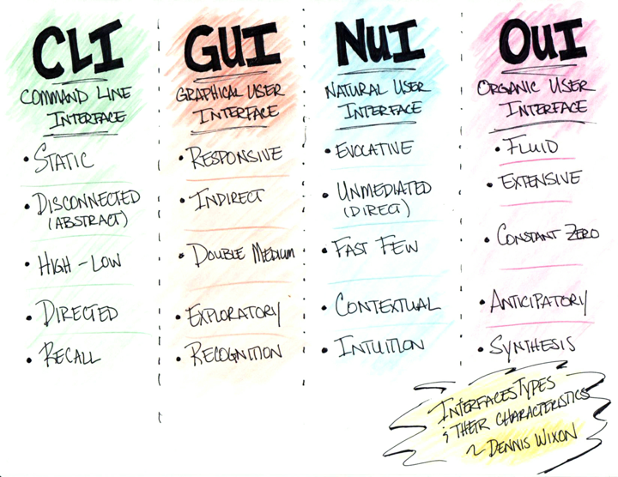
`
http://www.flickr.com/photos/rhinman/; http://farm4.staticflickr.com/3284/2799639297_3e967e6d79_o.jpg

Slide 25
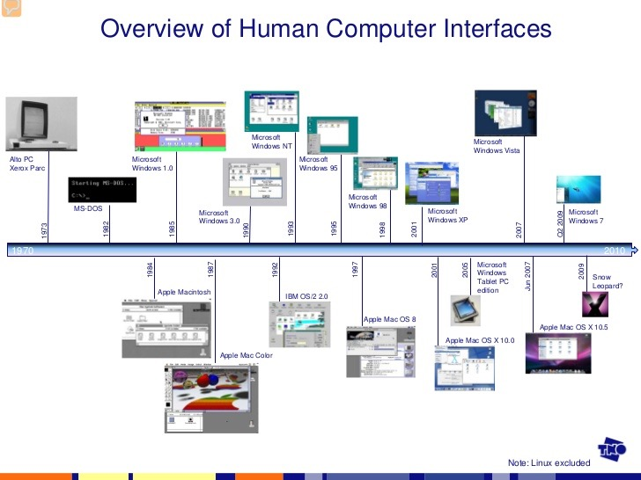
http://image.slidesharecdn.com/multitouchinteractionoverview-091201143806-phpapp02/95/multitouch-interaction-overview-59-728.jpg?cb=1259678334

Slide 26
Direct Manipulation
Benefits of direct manipulation interfaces
Novices can learn basic functionality quickly
often through a demonstration by a more experienced user
Experts can work extremely rapidly to carry out a wide range of tasks
even defining new functions and features
Knowledgeable intermittent users can retain operational concepts
Error messages are rarely needed
Users can see immediately if their actions are furthering their goals
if not, they can simply change the direction of their activity
Users have reduced anxiety
the system is comprehensible
actions are easily reversible
Notes:
ask students when they think this was formulated

Slide 27
Direct Manipulation in Context
the benefits from the previous slide apply nicely to NUIs
they were formulated in the 1980s by Ben Shneiderman
characterization of graphical user interfaces for direct manipulation
Shneiderman, B. (1984). The future of interactive systems and the emergence of direct manipulation.
Proc. of the NYU symposium on user interfaces on Human factors and interactive computer systems (pp. 1–28). Norwood, NJ, USA: Ablex Publishing Corp.
Retrieved from http://dl.acm.org/citation.cfm?id=2092.2093
in retrospect, GUIs are not a good example of direct manipulation
all manipulations are indirect, e.g. via a mouse

Slide 28
NUI vs. GUI
NUI advantages
better capabilities
new technologies
touch, gestures, speech
easier to learn
based on existing skills, experience, expertise
focus on natural behaviors
easier to use
direct manipulation taken further
real-world metaphors
GUI advantages
text input
precise manipulation

Slide 29
Organic User Interface (OUI)
interaction with real-world objects
overcomes the rigid structure of current interaction technology
in particular displays
“blobjects”
objects with organic shapes (“blobs”) instead of artificial geometric ones
often inspired by nature
long employed in some design efforts
full 3 dimensions
instead of 3D emulated on 2D technology (“flatland interfaces”)
deformability
natural for many real-world objects
balance between industrial and natural design
embedded computing
David Holman and Roel Vertegaal. 2008. Organic user interfaces: designing computers in any way, shape, or form. Commun. ACM 51, 6 (June 2008), 48-55. DOI=http://dx.doi.org/10.1145/1349026.1349037
Notes:
Examples of

Slide 30
OUI Examples
Liftware spoon
stabilizing and leveling handles and attachments
designed to help people with hand tremor or limited hand and arm mobility
Smart sports equipment
golf clubs, tennis rackets, boxing gloves, soccer ball, …

Slide 31
Skills
simple skills
learned skills that depend mostly on innate abilities
easy to learn
low cognitive load
easy to re-use and adapt
examples
pointing, grasping, tapping,
composite skills
learned skills that depend on other simple or composite skills
take more effort to learn
higher cognitive load
often require conscious effort and practice
often used for more advanced tasks

Slide 32
Examples Composite Skills
object manipulation via mouse
conversion of mouse movements into pointer movements
mapping of mouse actions to object manipulation actions
click and hold to drag
double-click, control-click, etc.
scrolling to view hidden screen content
user must be aware that there is more content than can be seen
translation of user actions into scrolling actions
scrolling via touchpad vs. scrolling via scroll bar
navigation of folders
terminology confusion: document, file, folder, directory, file system
hierarchical structure
multiple display options: icons, list, indented list, multiple panes, tree

Slide 33
Composite Skills and NUIs
touch
gestures
speech

Slide 34
Cognitive Load
measure of the working memory required to perform a task
working memory capacity is limited
skills and cognitive load
using skills increases cognitive load
composite skills have higher cognitive load

Slide 35
Cognitive Load Types
intrinsic
inherent difficulty of the task or subject matter
difficult or impossible to change
extraneous
cognitive load imposed by the interaction method
adjusting loudness in a car radio
knob
touch panel
should be minimized
germane
involved in processing and understanding the task or subject matter
requires task and domain knowledge
can be reduced by good interaction design

Slide 36
Cognitive Load Types
and HCI
Cognitive load type | HCI description | Example
Intrinsic | inherent difficulty of the task | Interaction design cannot change the difficulty, but difficult tasks can be split into sub-tasks.
Extraneous | load created by the skills used in the interaction | A poorly designed interaction can make the user think more than necessary. A well-designed interaction can seem completely natural.
Germane | load involved in learning the interface | Well-designed interfaces focus on progressively teaching the user how to use it.
Intrinsic Extraneous
Germane
HCI description
The inherent difficulty of the task.
The load created by the skills used in the interaction.
The load involved in
learning the interface.
Example
Interaction design cannot change the difficulty, but difficult tasks can be split into sub-tasks.
A poorly designed interaction can make the user think more than necessary while a well-designed interaction can seem completely natural.
Well-designed interfaces focus on progressively
teaching the user how to use it.

Slide 37
Natural Interaction Guidelines
enable instant expertise
reduce cognitive load
induce progressive learning
utilize direct interaction

Slide 38
Instant Expertise
Reuse Skills
common human skills
simple
composite
often based on
objects
containers
gestures
manipulations
skills based on task or domain expertise
users know how to do certain things
not all users may have the same set of skills
some skills may be obsolete or counterproductive
new tool requires different methods, workflow
most of theses skills are composite skills

Slide 39
Cognitive Load
design the most common interactions to use innate abilities and simple skills
low cognitive load
easy to learn
may conflict with the reuse of “instant expertise” skills
e.g. touch-based interaction vs. re-use of mouse skills

Slide 40
Progressive Learning
if reuse doesn’t work, teach simple skills
easier to learn than composite skills
enables progressive learning
advanced tasks should be broken down into subtasks that use simple skills
present novice users with basic tasks first
examine paths for common usage scenarios that lead from basic tasks to complex tasks
reduce the number of options exposed to the user
advanced options should be available to experienced users
may be more difficult to access

Slide 41
Direct Interaction
direct
identification of the object to interact with
manipulation of the object
works well with touch and gesture-based methods
touch or apply gesture to an object visible on the screen
more difficult with voice, virtual reality
identification of objects through speech can become complicated
“the green square in the upper left corner of the screen”
lack of haptic feedback for VR

Slide 42
Directness Types
spatial proximity
user action is close to the object
may be simulated via avatars
e.g. in virtual reality settings, 3-D
temporal proximity
user action and interface re-action are (close to) simultaneous
parallel action
user action and interface reaction overlap in at least one degree of freedom
most often: object moves in the same direction as the user’s action

Slide 43
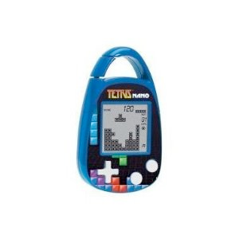
Case Study: Direct Interaction with Tetris
basic operations
problem space
interaction space
Tetris Devices

Slide 44
Tetris Interaction Analysis
basic operations
input: Human => Tetris device
output: Tetris device => human
dependencies between operations
sequential
concurrent
mutually exclusive
...

Slide 45
Tetris Operations
select object
default
move left, move right
move up, move down
rotate left, rotate right
start
sound on/off
reset

Slide 46
Tetris “Game Space”
Problem Space
Start Node
Goal(s) Node
States
Operators
transition from one state to another state
Heuristics
ranking of successor nodes
Interactions
input
channels
actions
constraints
output

Slide 47
Tetris “Interaction Space”
Infrastructure
transmission channels and media
used to transmit messages between “interactors”
alphabet
common set of symbols
blocks: shape, color
controls: start, stop, rotate, left, right, ??
encoding and decoding
mapping between different representation schemes
internal
external
Information Flow
input
channels
actions
constraints
output

Slide 48
Dedicated Tetris Devices
handheld toys specifically designed for Tetris
Tetris Jr. (key chain)
Radica Big Screen Tetris
Radica Tetris 360

Slide 49
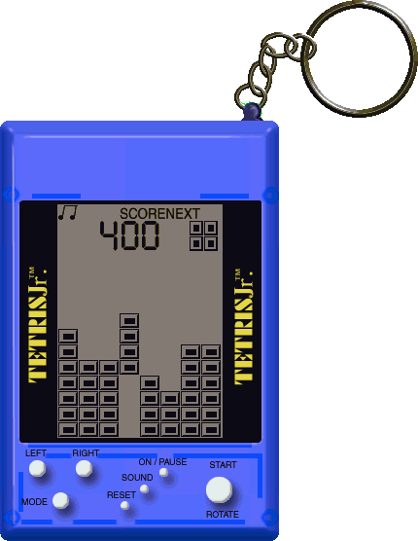
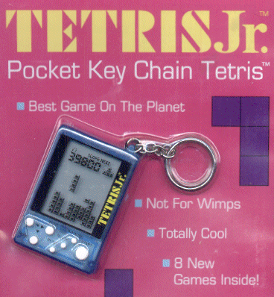
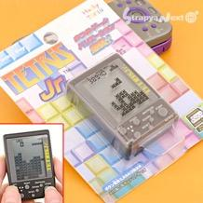
Tetris Jr.
http://theodor.lauppert.ws/games/s/images2/tetrisjr.png
http://theodor.lauppert.ws/games/s/screen1/tetrisjr.gif
key chain device
black and white display
Tetris blocks
score
seven input buttons
LEFT, RIGHT
ROTATE/START
MODE
ON/PAUSE
SOUND
RESET
http://www.strapya-world.com/images/medium/56/56-900105_MED.jpg

Slide 50
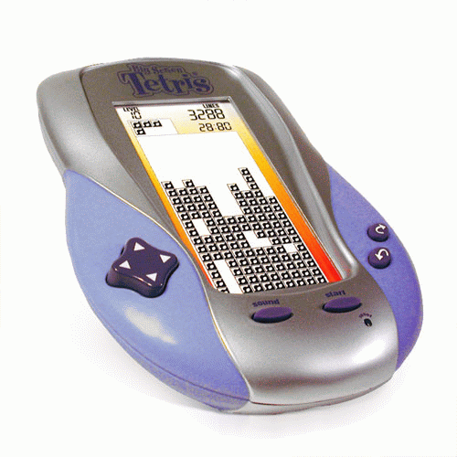
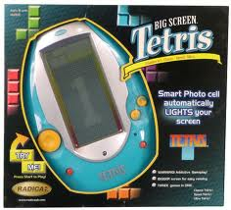
Radica Big Screen Tetris
larger device
B&W
nine buttons
LEFT/RIGHT/UP/DOWN
ROTATE LEFT/RICHT
START
SOUND
RESET
http://static.productreview.com.au/pr.products/35851_big_screen_tetris.gif

Slide 51

Radica Big Screen Tetris 2
http://static.productreview.com.au/pr.products/35851_big_screen_tetris.gif
http://spielzeug-express.de/media/catalog/product/cache/1/image/9df78eab33525d08d6e5fb8d27136e95/i/m/image_2953.jpg

Slide 52
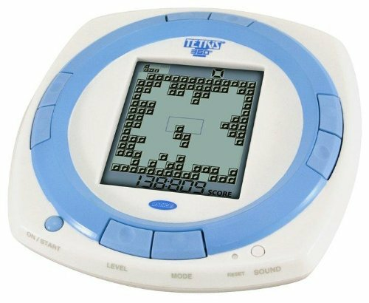
Radica Tetris 360
Tetris variation
eleven buttons
http://kidstoysheaven.com/img/mattel-radica-tetris-360_70967_250.jpg

Slide 53
Tetris on Game Stations
variations of Tetris have been implemented on many game stations
straightforward mapping of operations to game station controllers
directional pad (C-Up, C-Down, C-Left, C-Right)
Start
analog joy stick

Slide 54
Tetris on Computers
variations of Tetris are available for most consumer-oriented computer systems
mapping of operations
keyboard
cursor keys
other keys for remaining operations
mouse
move operations easy
rotate less obvious

Slide 55
Voice-Controlled Tetris
mapping of voice commands on equivalent key controls
“press right arrow”, ...
also shortcuts: “go right”, “go left”, ...
doesn’t work with all implementations
Flash-based versions appear to be difficult
References
Play Tetris with your voice. (n.d.). Retrieved May 29, 2012, from http://hand2mouth.wordpress.com/2009/09/03/play-tetris-with-your-voice/
Sporka, A. J., Kurniawan, S. H., Mahmud, M., & Slavík, P. (2006). Non-speech input and speech recognition for real-time control of computer games (p. 213). ACM Press. doi:10.1145/1168987.1169023
Yuan, X., & Fan, J. (2011). Design and implementation of voice controlled Tetris game based on Microsoft SDK. Multimedia Technology (ICMT), 2011 International Conference on (pp. 275 –278). doi:10.1109/ICMT.2011.6001825

Slide 56
Touch-Based Tetris
many variations of Tetris on smartphones, tablets
direct mapping of operations to touch-based gestures
move => drag, swipe
rotate => semi-circular swipe
References
Collberg, C., Kobourov, S., Kobes, S., Smith, B., Trush, S., & Yee, G. (2003). TetraTetris: A Study of Multi-User Touch-Based Interaction Using DiamondTouch. Human-computer interaction: INTERACT’03; IFIP TC13 International Conference on Human-Computer Interaction, 1st-5th September 2003, Zurich, Switzerland (p. 81).
Tetris, Touch API and Android. (n.d.).RIAgora. Retrieved May 29, 2012, from http://www.riagora.com/2010/05/tetris-touch-api-and-android/

Slide 57
Tetris and BCI
sometimes used as a test for BCI devices
CSC 484 class (find project?)

Slide 58
Human Tetris
performance by Guillaume Reymond
http://www.youtube.com/watch?feature=player_detailpage&v=G0LtUX_6IXY
Tetris skaters
http://www.youtube.com/watch?feature=player_detailpage&v=Fwvc6fmXmuY
game show patterned after Tetris
a styrofoam wall consisting of Tetris blocks moves towards the contestants
contestants have to position themselves so that they can fit through the openings
otherwise they are pushed into a pool of water
also known as “Brain Wall” or “Hole in the Wall”
comes in many different variation in many countries
References
36 Skaters Make Downhill Neon Video Game w/ Freebords. (2009). Retrieved from http://www.youtube.com/watch?v=Fwvc6fmXmuY&feature=youtube_gdata_player
It’s People. Tetris is Made Out of People! - Technabob. (n.d.). Retrieved May 29, 2012, from http://technabob.com/blog/2007/12/31/its-people-tetris-is-made-out-of-people/
The Original Human TETRIS Performance by Guillaume Reymond. (2007). Retrieved from http://www.youtube.com/watch?v=G0LtUX_6IXY&feature=youtube_gdata_player

Slide 59
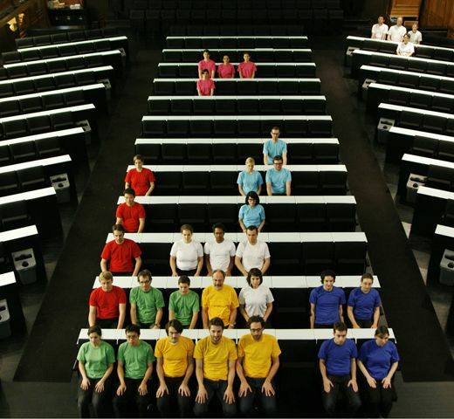
Human Tetris 2
http://technabob.com/blog/wp-content/uploads/2007/12/human_tetris.jpg

Slide 60
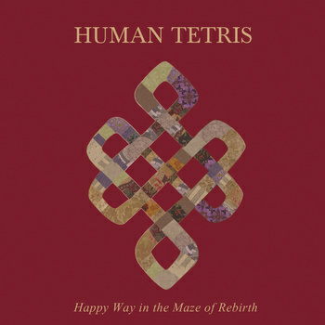
Human Tetris 3
band from Moscow
http://humantetris.bandcamp.com/
http://www.facebook.com/pages/Human-Tetris/132302626840565
http://humantetris.bandcamp.com/album/happy-way-in-the-maze-of-rebirth

Slide 61
Tetris and AR/VR
Tetris is used as experimental scenario for human-computer interaction in augmented and virtual reality systems
several versions available or under development for MS Kinect
mapping of operations to actions
move => grab & drag
rotate => grab & rotate
single-handed or two-handed

Slide 62
Tetris and AR/VR
References
Ha, T., & Woo, W. (2006). Bare Hand Interface for Interaction in the Video See-Through HMD Based Wearable AR Environment. In R. Harper, M. Rauterberg, & M. Combetto (Eds.), Entertainment Computing - ICEC 2006, Lecture Notes in Computer Science (Vol. 4161, pp. 354–357). Springer Berlin / Heidelberg. Retrieved from http://www.springerlink.com/content/r85485233j450661/abstract/
Lee, K. J., Ahn, S. C., & Kim, H.-G. (2006). Using a mobile device as an interface tool for HMD-based AR applications. Proceedings of the 2006 ACM SIGCHI international conference on Advances in computer entertainment technology, ACE ’06. New York, NY, USA: ACM. doi:10.1145/1178823.1178833
Parsons, T. D., Rizzo, A. A., Rogers, S., & York, P. (2009). Virtual reality in paediatric rehabilitation: A review. Developmental Neurorehabilitation, 12(4), 224–238. doi:10.1080/17518420902991719
Passig, D., & Eden, S. (2001). Virtual Reality as a Tool for Improving Spatial Rotation among Deaf and Hard-of-Hearing Children. CyberPsychology & Behavior, 4(6), 681–686. doi:10.1089/109493101753376623
TechCrunch | Play Tetris Through The Kinect. (n.d.).TechCrunch. Retrieved May 29, 2012, from http://techcrunch.com/2011/07/05/play-tetris-through-the-kinect/

Slide 63
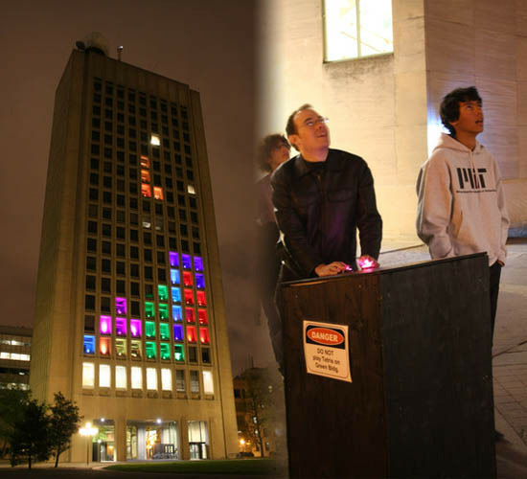
Real-World Tetris
Tetris played with buildings
Delft University
MIT
http://zapp5.staticworld.net/images/article/2012/04/tetris-11351126.jpg

Slide 64
Real-World Tetris
References
MIT Students Hack Building, Play Tetris [VIDEO]. (n.d.).Mashable.
Retrieved May 29, 2012, from http://mashable.com/2012/04/23/tetris-building/
Tetris for Buildings - November 1995 - Two Thousand Square Meter Of Tetris (23.94M). (2010).
Retrieved from http://www.youtube.com/watch?v=LwNQqePk8Kg&feature=youtube_gdata_player

Slide 65
DevScope
How NUIs are changing HCI.
Marco Silva
Marco Silva, DevScope: How NUIs are changing HCI; http://marconsilva.livethoughts.net

Slide 66
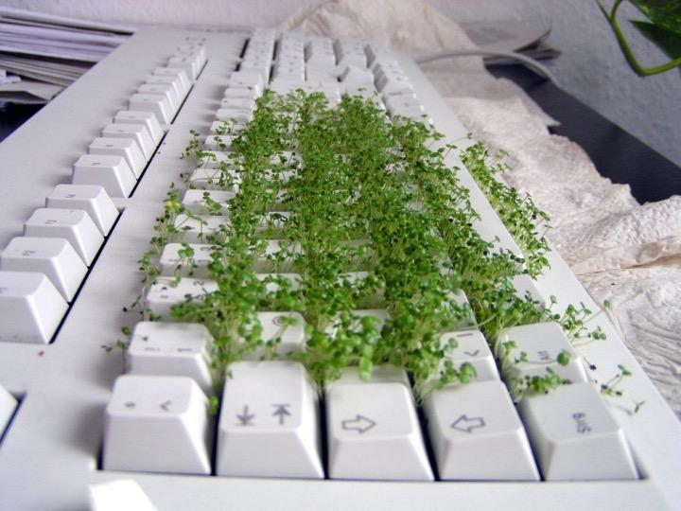
Keyboard
From Flickr user Dirk Gently
Marco Silva, DevScope: How NUIs are changing HCI; http://marconsilva.livethoughts.net

Slide 67
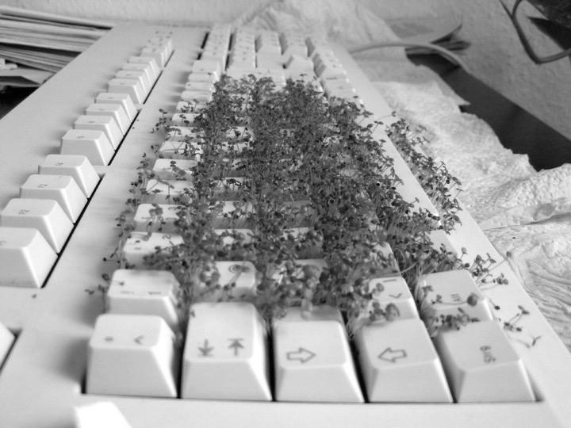
Keyboard
Text Based UI
Both Input and Output
From Flickr user Dirk Gently
Marco Silva, DevScope: How NUIs are changing HCI; http://marconsilva.livethoughts.net

Slide 68

Mouse
Mouse
From Flickr user Phantasy Photo
Marco Silva, DevScope: How NUIs are changing HCI; http://marconsilva.livethoughts.net

Slide 69

Mouse
Graphics
Exploration
Mouse
From Flickr user Phantasy Photo
Marco Silva, DevScope: How NUIs are changing HCI; http://marconsilva.livethoughts.net

Slide 70

Marco Silva, DevScope: How NUIs are changing HCI; http://marconsilva.livethoughts.net

Slide 71
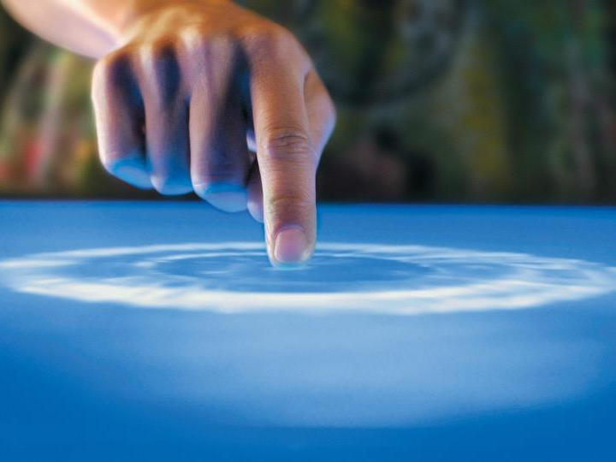
Touch
Marco Silva, DevScope: How NUIs are changing HCI; http://marconsilva.livethoughts.net

Slide 72
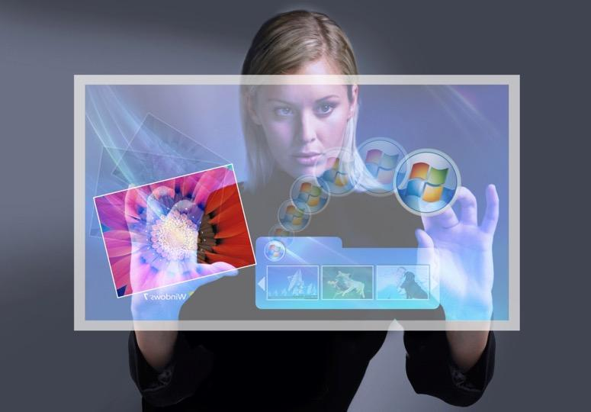
Gestures
Marco Silva, DevScope: How NUIs are changing HCI; http://marconsilva.livethoughts.net

Slide 73
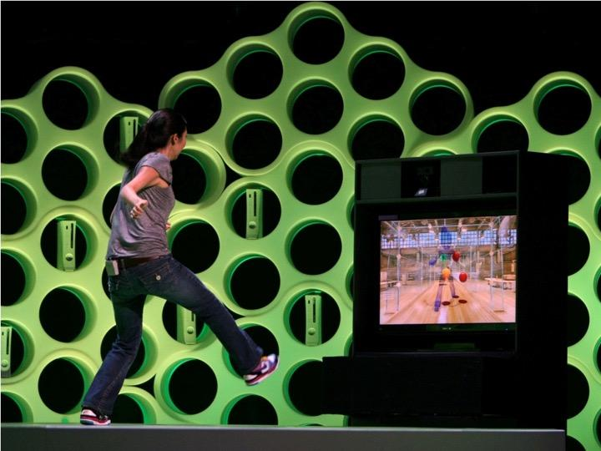
Touchless
Marco Silva, DevScope: How NUIs are changing HCI; http://marconsilva.livethoughts.net

Slide 74
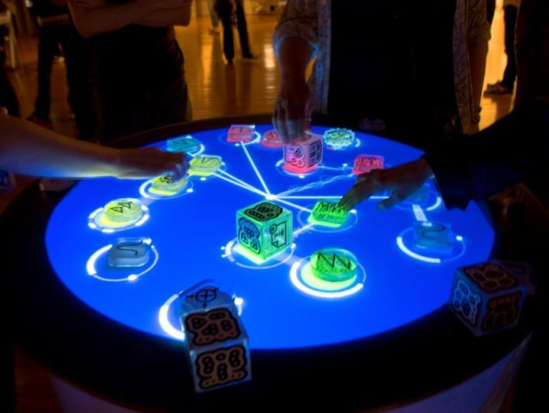
Object Recognition
Marco Silva, DevScope: How NUIs are changing HCI; http://marconsilva.livethoughts.net

Slide 75

Voice
Marco Silva, DevScope: How NUIs are changing HCI; http://marconsilva.livethoughts.net

Slide 76
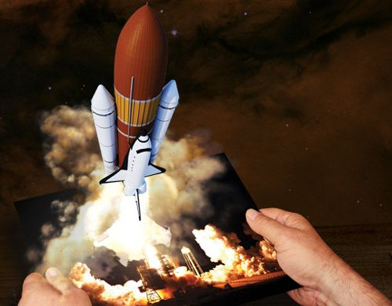
Augmented Reality
Marco Silva, DevScope: How NUIs are changing HCI; http://marconsilva.livethoughts.net

Slide 77
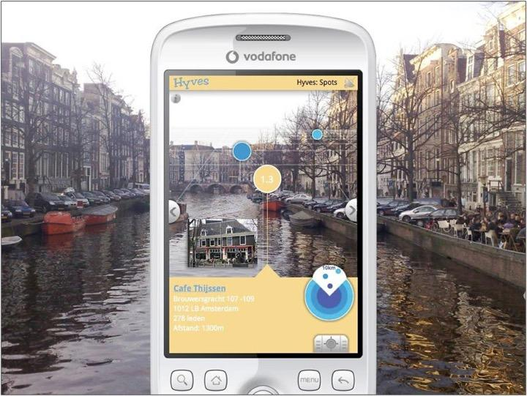
Marco Silva, DevScope: How NUIs are changing HCI; http://marconsilva.livethoughts.net

Slide 78
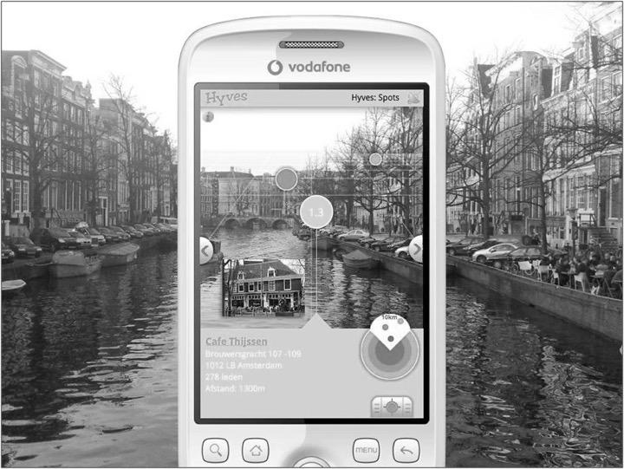


Marco Silva, DevScope: How NUIs are changing HCI; http://marconsilva.livethoughts.net

Slide 79


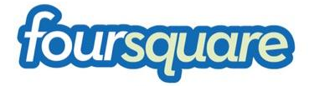
Marco Silva, DevScope: How NUIs are changing HCI; http://marconsilva.livethoughts.net

Slide 80
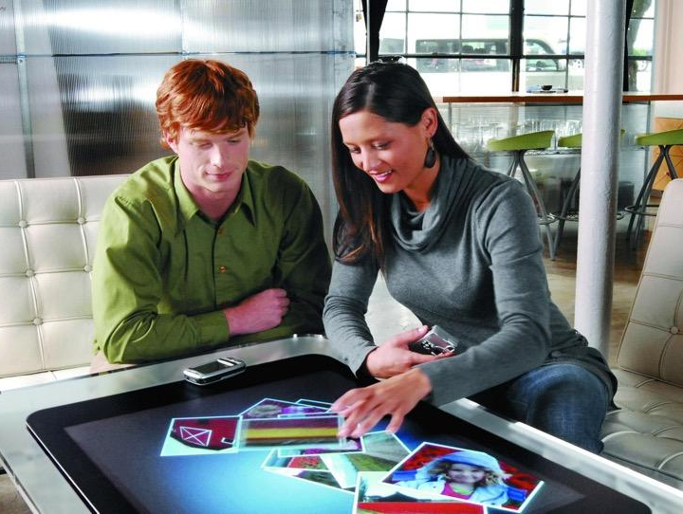
Marco Silva, DevScope: How NUIs are changing HCI; http://marconsilva.livethoughts.net

Slide 81
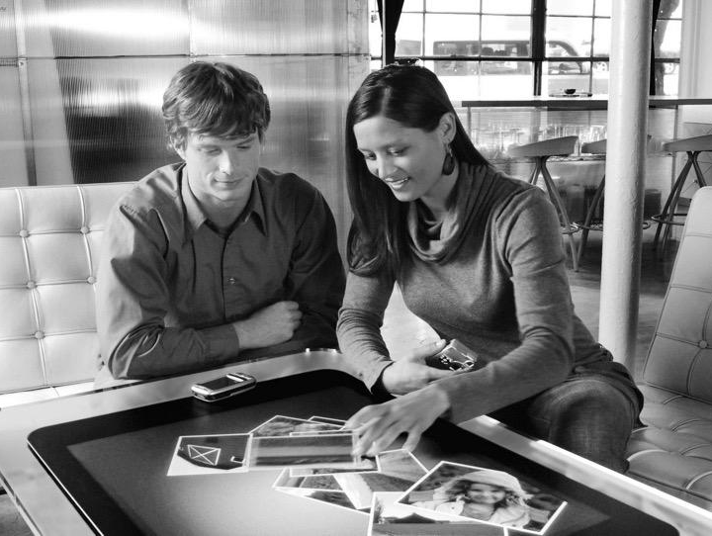
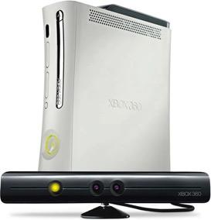
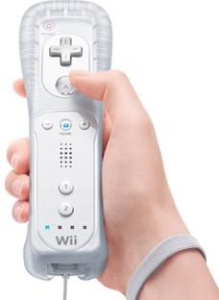
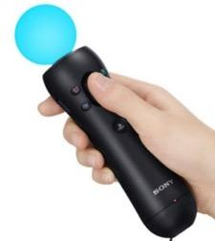
Marco Silva, DevScope: How NUIs are changing HCI; http://marconsilva.livethoughts.net

Slide 82
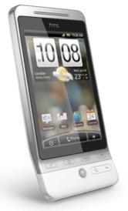
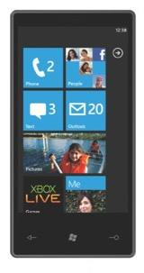
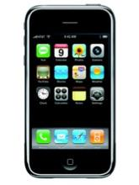
Marco Silva, DevScope: How NUIs are changing HCI; http://marconsilva.livethoughts.net

Slide 83
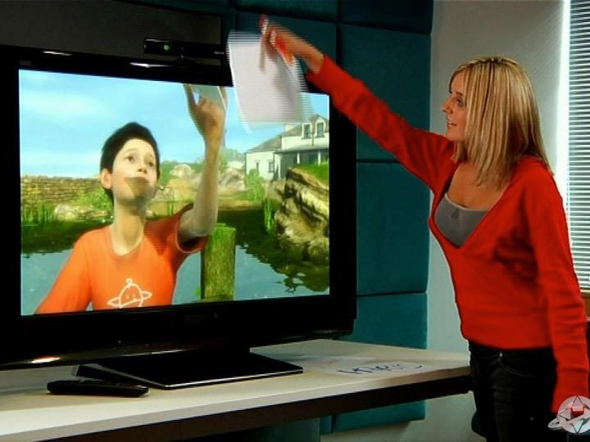
Lionhead Studios “Milo”
Marco Silva, DevScope: How NUIs are changing HCI; http://marconsilva.livethoughts.net
Notes:
http://www.3djuegos.com/foros/tema/1216059/0/todo-sobre-milo/

Slide 84
Speech as NUI
natural interaction method for human-human communication
speech recognition sufficient for basic human-computer interaction
used in intelligent assistants like Amazon’s Alexa, Apple’s Siri, Google Assistant, Samsung Bixby
limited to
commands
queries
simple dialogs
conversation out of reach
very limited comprehension
difficulties resolving ambiguities

Slide 85
Natural Interaction Application
reuse innate abilities
reuse basic skills
acquire new skills
learn tasks

Slide 86
Reuse Innate Abilities
object permanence
objects still exist even if they’re not visible
important milestone in cognitive development of children
users expect objects to be in the location and condition they left them
applies to documents and other objects
example: file management
relies heavily on object permanence
requires composite skills
touch-based devices often hide file management
if necessary, handled by applications
content-centric interaction
emphasis on content objects, not applications
photos, text documents, email messages, ...

Slide 87
Reuse Basic Skills
containment relationship
putting objects into other objects
very natural for some objects
very un-natural for others
example: categorizing items
categories are (virtual) containers
items with the same properties are moved into one container

Slide 88
Excursion: Categorization and Cognitive Load
Which of the following options for categorizing items have high or low cognitive loads, respectively?
category list box, list of item with check boxes, apply button
list of items with drop down lists of categories per item
side-by-side lists with arrow buttons to move items
e.g., all items in a list on the left, specific category on the right
dragging items into containers that represent categories

Slide 89
Acquire New Skills
transfer of skills
application of the pinch gesture to text
intended result is a change in font size
demonstration of skills
explicit display of a skill to a novice user
disruptive for instructor and learner
social observation of skills
casual observation of other users
no interruption of their activities
requires an opportunity to observe others

Slide 90
Learning Tasks
tasks that are enhanced specifically to teach a particular skill or interaction pattern
often incorporates demonstration and practice activities

Slide 91
Post-test
Notes:
evaluate the learning success of the participants
provide feedback to the students about their achievements
ask for feedback on unclear or difficult parts
point out possible gaps and difficulties
encourage suggestions for improvement

Slide 92
References
Academic Articles
Câmara, António. "Natural user interfaces." Proceedings of the 13th IFIP TC 13 international conference on Human-computer interaction-Volume Part I 5 Sep. 2011: 1-1.
Del Ra, W. (2011). Brave NUI world. ACM SIGSOFT Software Engineering Notes, 36(6), 29. doi:10.1145/2047414.2047439
Handschuh, S., Aroyo, L., & Thai, V. (2011). Visual interfaces to the social and semantic web (VISSW 2011). Proceedings of the 15th international conference on Intelligent user interfaces - IUI ’11 (p. 475). Presented at the the 15th international conference, Palo Alto, CA, USA. doi:10.1145/1943403.1943508
Hofmeester, K., & Wixon, D. (2010). Using metaphors to create a natural user interface for microsoft surface (p. 4629). ACM Press. doi:10.1145/1753846.1754204
Jain, J., Lund, A., & Wixon, D. (2011). The future of natural user interfaces (p. 211). ACM Press. doi:10.1145/1979742.1979527
König, W. A., Rädle, R., & Reiterer, H. (2009). Squidy (p. 4561). ACM Press. doi:10.1145/1520340.1520700
Malizia, A., & Bellucci, A. (2012a). The artificiality of natural user interfaces. Communications of the ACM, 55(3), 36. doi:10.1145/2093548.2093563
Maybury, M. (1999). Intelligent user interfaces (pp. 3–4). ACM Press. doi:10.1145/291080.291081
Norman, D. A. (2010). The way I see it: Natural user interfaces are not natural. interactions, 17(3), 6. doi:10.1145/1744161.1744163
Seow, S. C., Wixon, D., Morrison, A., & Jacucci, G. (2010). Natural user interfaces. Proceedings of the 28th of the international conference extended abstracts on Human factors in computing systems (pp. 4453–4456). Presented at the CHI EA ’10, ACM Press. doi:10.1145/1753846.1754172
van Dam, A. (1997). Post-WIMP user interfaces. Communications of the ACM, 40(2), 63–67. doi:10.1145/253671.253708
van Dam, A. (2001). User interfaces: disappearing, dissolving, and evolving. Communications of the ACM, 44(3), 50–52. doi:10.1145/365181.365192

Slide 93
References
Other Sources
Natural user interface - Wikipedia
Natural User Interface - Microsoft Research
NUI Group
NUI (Natural User Interface) Vimeo Channel
Marco Silva. (2010, May 13). How Natural User Interfaces are changing Human Computer Interaction. Retrieved from http://www.slideshare.net/marconsilva/how-natural-user-interfaces-are-changing-human-computer-interaction
Natural User Interface Multitouch Software. (2007). Retrieved from http://www.youtube.com/watch?v=oD-SacHOKqc&feature=youtube_gdata_player
Cognition & The Intrinsic User Experience (thejordanrules.posterous.com)
OUI Brave a NUI World (threeminds.organic.com)
Are We Moving Toward A More Natural Future With Technology? (InnovationToronto.com)
How Can Leap's New Motion Controller Top Kinect PCs? (rant4u.com)
Microsoft shows off NUI, Kinect-focused research projects (zdnet.com)

Slide 94
Evaluation

Slide 95
Important Concepts and Terms

Slide 96
Chapter Summary

